Slide 1
BAFA case study
Dr Jim Briggs

Slide 2
Introduction to the case study
Why do a case study?
What sort of organisation(s) to study?

Slide 3
BAFA
British American Football Association
National Governing Body for American football in Great Britain
Consists of 4 organisations:
BAFA Community League (BAFA CL)
British Universities American Football League (BUAFL)
British American Football Coaches Association (BAFCA)
British American Football Referees Association (BAFRA)

Slide 4
What does an NGB do?
Overall ruling body for a national sport
May organise their own competitions (e.g. leagues, cups)
Often involved in organising national team
Typically involved in promoting their sport:
encouraging people to play it
making sure there are enough coaches and officials
overseeing qualifications in various aspects of their sport
In some sports:
there is one NGB for the whole of the UK
there are separate ones for England, Scotland, Wales and Northern Ireland

Slide 5
Examples of NGBs
The Football Association
Rugby Football Union
England and Wales Cricket Board
England Netball
English Lacrosse
England Basketball
British Volleyball
English Ice Hockey Association
British Orienteering
The Sport and Recreation Alliance (the collective body of NGBs) – 320 members

Slide 6
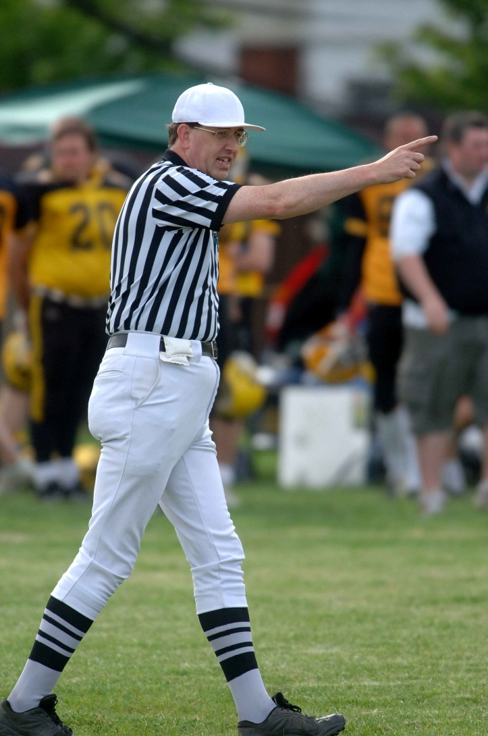
How do I know this?
American football Referee since 1984
President of BAFRA 2006-2010
Director of BAFA 2006-2010

Slide 7
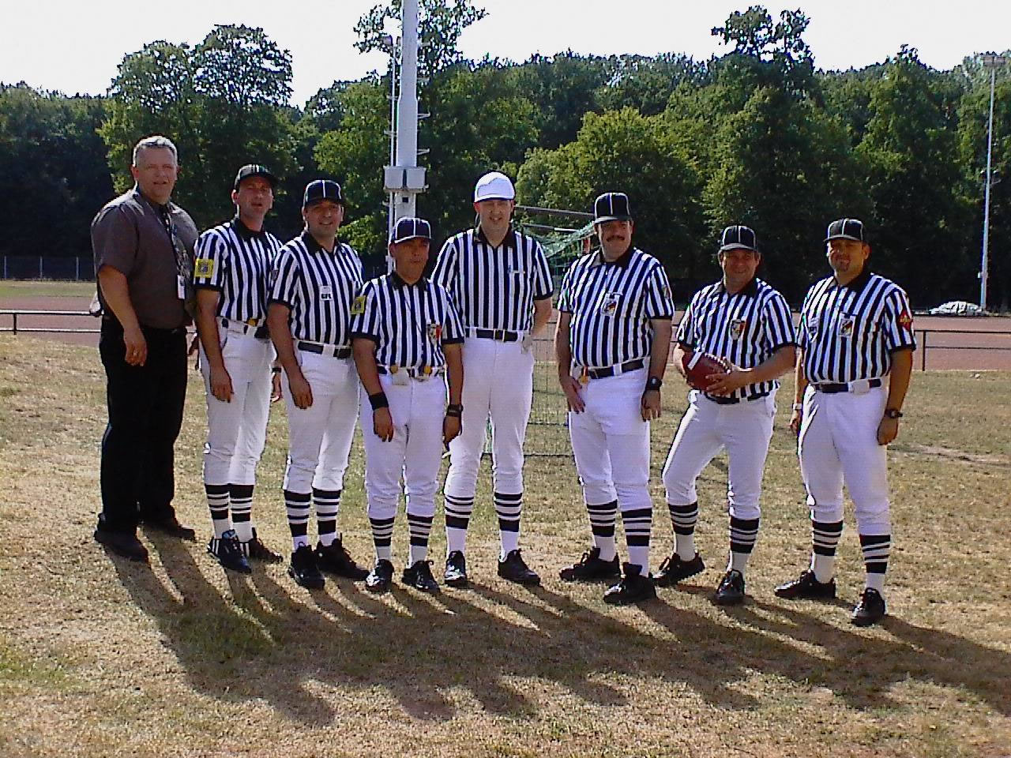
Career highlights
With my crew before the 2003 World Cup final between Japan and Mexico

Slide 8
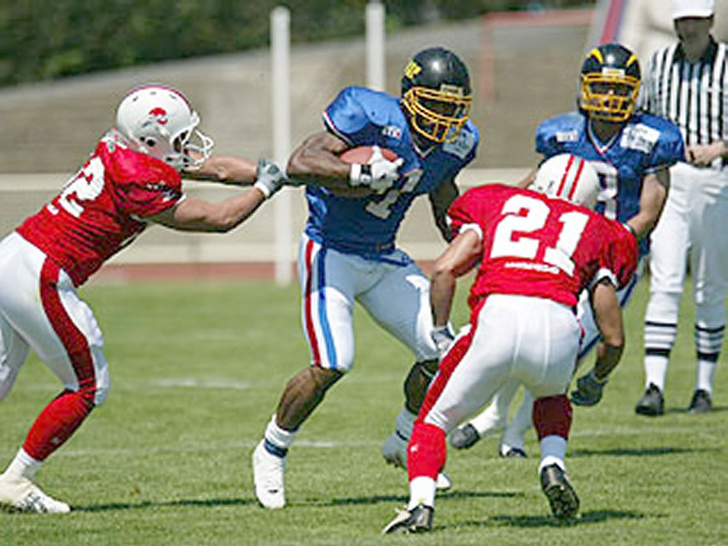
Career highlights
Me during the semi-final between Japan and France, World Cup 2003

Slide 9
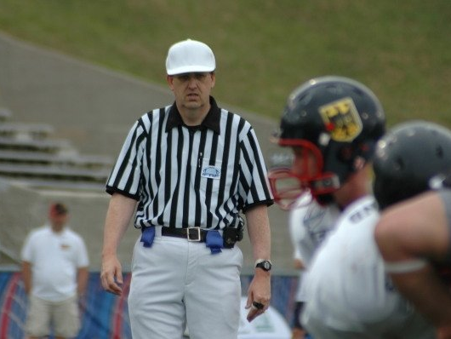
Career highlights
Germany vs New Zealand, Junior World Championship, 2009

Slide 10
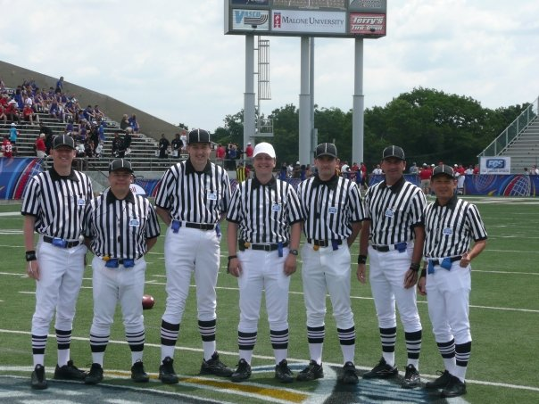
Career highlights
The crew for the Junior World Championship final between USA and Canada, 2009

Slide 11
Some questions…
For an organisation such as a NGB:
why does it need a website?
how does it go about getting a website?
what should its website contain?
what technologies should it use?
and who is going to provide them?
how does it manage a website?
and what do we mean by "manage"?

Slide 12
Managing a website
Hosting
Content management
including user contributed content
Structure, architecture and navigation
Security
Monitoring and evaluation
Recovery and backup
Legal issues
Scalability

